Slide 1
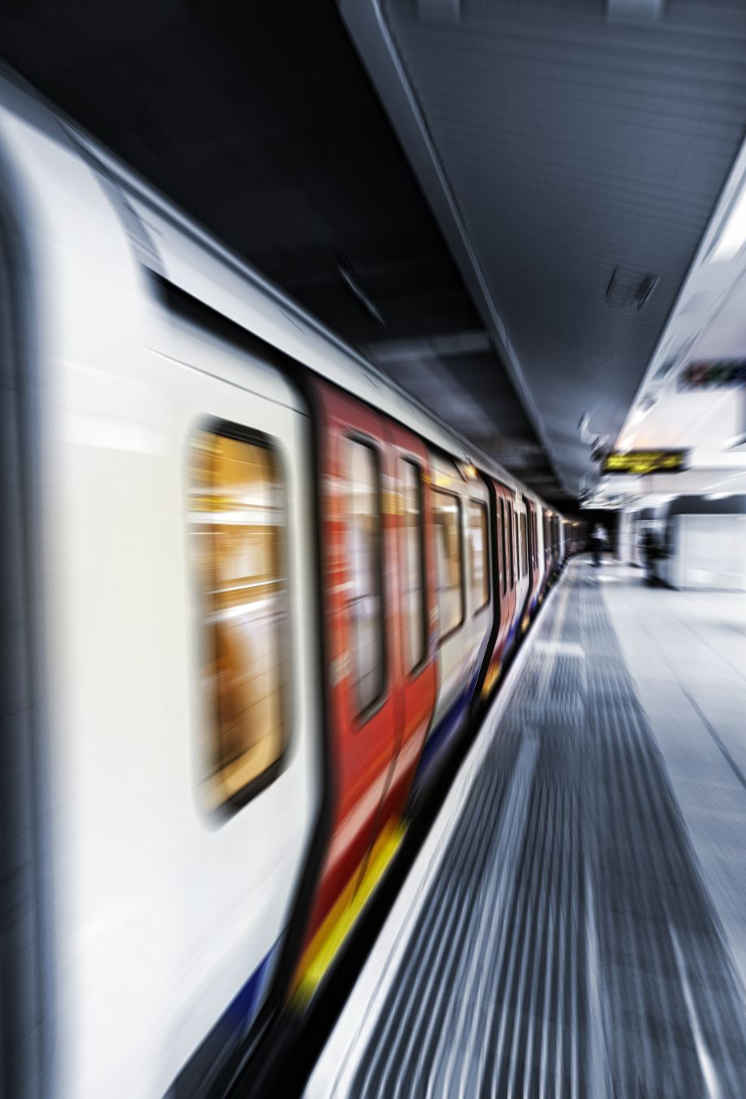
Economic and Environmental Impacts of Modal Shift to Light Rail Transit: A Case Study from San José, Costa Rica
March 25, 2024

Slide 2
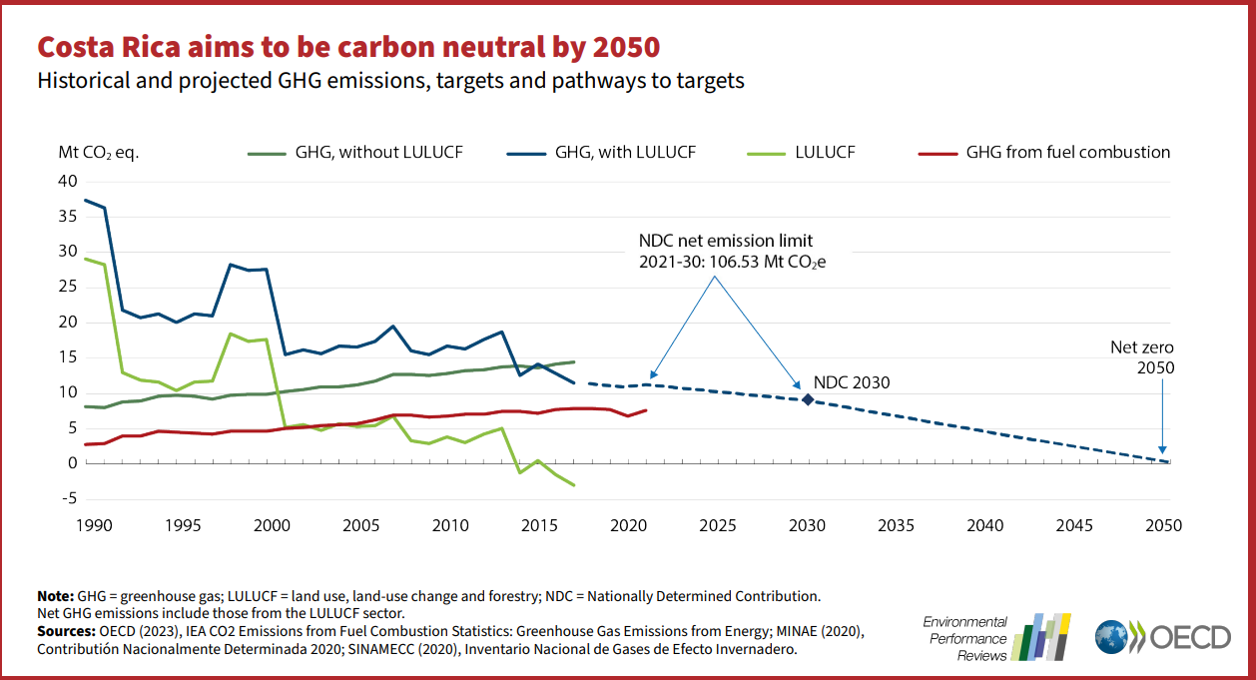
Background
Costa Rica aims to achieve net-zero emissions by 2050
Transportation accounts for a significant portion of the country's emissions
The "Light Rail at the Metropolitan Area Costa Rica" project is a GCF-funded initiative to implement a low-carbon sustainable transport system

Slide 3
Intended Outcomes (source: GCF Funding Proposal FP166)
Increased usage of a sustainable low-emission urban transport system
Increased capacity of stakeholders to replicate NMT and connectivity interventions
Reduced economic costs of mobility and air pollution
Reduced dependency on fossil fuel imports

Slide 4
Unintended Outcomes
Gentrification and displacement of low-income residents in areas surrounding the light rail stations
Increased property values and rental rates near the light rail stations
Potential loss of small businesses and informal economic activities due to changes in land use
Increased traffic congestion during the construction phase
Impacts on cultural heritage sites or historic neighborhoods along the light rail route

Slide 5
Indicators
Transportation Indicators:
Traffic Congestion: traffic flow & congestion in construction.
Transit Ridership: public transport ridership (light rail).
Air Quality: Variation in pollutant levels (e.g., PM2.5, NOx, SO2)
Economic and Housing Indicators:
Property Values: Trends in property prices in proximity to the light rail stations
Rental Rates: Changes in rental costs near the light rail route compared to other areas.
Business Activity: Impact on local businesses, including closures, openings, and economic performance.
Displacement Patterns: Incidence and demographics of displaced residents due to rising costs or redevelopment.
Socioeconomic Impacts: Effects on different socioeconomic groups, including income and employment changes.
Spatial Indicators:
Land Use Changes: Alterations in land use patterns along the light rail corridor.
Gentrification Hotspots: Identification of areas experiencing rapid socio-economic and cultural changes.
Connectivity and Accessibility: Changes in accessibility to services and amenities due to the light rail.
Stakeholder Perspective Indicators:
Community Feedback: Insights from surveys, interviews, or focus groups (e.g. women) on perceived impacts of the project.
Stakeholder Viewpoints: Perspectives of key stakeholders, including local authorities, businesses, and residents, on unintended impacts.

Slide 6
Data Sources
Quantitative :
Travel Surveys
National Household Travel Survey (ENVIH) - Ministry of Public Works and Transportation
Traffic Counts and Transit Ridership
Automatic traffic recorder data - CONAVI (national road network)
Bus and rail ridership data - INCOFER (Rail Institute)
Economic Impact
House price data (Global Property Guide, Numbeo)
Business/employment data (Economic Census INEC, World Bank)
Spatial Data
Satellite imagery (Google Earth, Planet Labs)
Geographic data (National Geographic Institute - IGNCR)
Qualitative:
Household Surveys
Living Standards Measurement Surveys (World Bank)
Population and Housing Census (INEC)
Public Sentiment
Social media data (Twitter X, Instagram, Tiktok) - Tools like Crimson Hexagon
Stakeholder Perspectives
Interview/focus group transcripts
Community outreach by local transportation authorities
Passenger Survey

Slide 7

Sentiment Analysis - Generative AI
Collect interview transcripts, social media posts, passenger feedback
Use large language models like GPT-4, Sonnet, Gemini etc.
Models can directly classify sentiment (positive/negative/neutral)
Generate sentiment classifications and summaries
Extract key themes driving +/- feedback

Slide 8
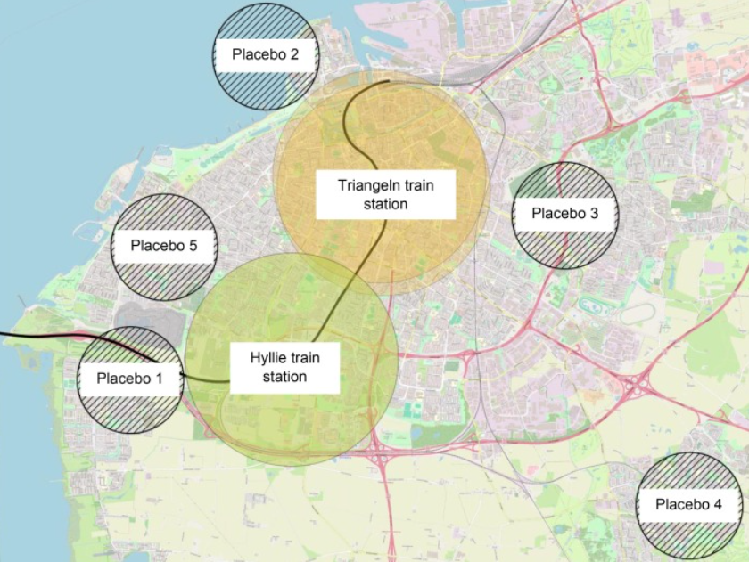
Housing and Gentrification
Quantile regression models on satellite imagery and census data estimating quantile treatment effects of rail proximity on distributions of house prices, demographics (income, education, race/ethnicity)
Identify areas with disproportionate house price impacts across quantiles and shifts towards higher/lower quantiles of demographics indicating gentrification/displacement patterns
Methodology based on: Sundbyberg, W & Merril, L. (2024). Impact of Commuter Rail on Neighborhood Housing Prices: Evidence from the Stockholm Metropolitan Area. Journal of Transport Geography, 95, 103-124. https://doi.org/10.1016/j.jtrangeo.2024.103184"

Slide 9
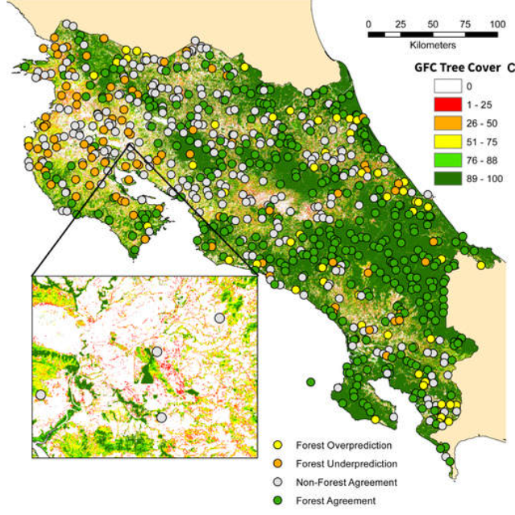
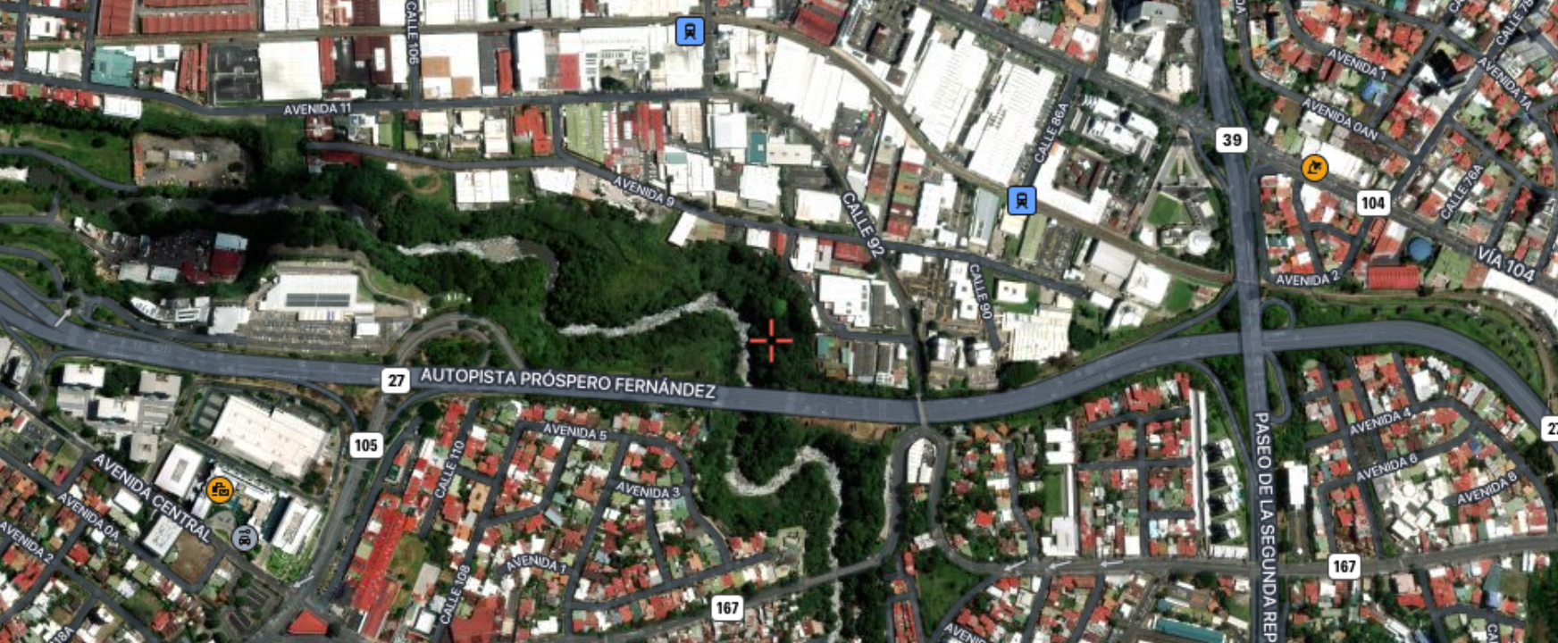
Business and Deforestation - Change Detection
Use high-resolution satellite imagery for areas along rail corridor
Change detection algorithms to identify new construction, demolitions, deforestation
Combine with business registration data and heritage site locations

Slide 10

Q&A
Thank you!

